Slide 1
SQL Server Index Structure
Module 5

Slide 2
Learning Units covered in this Module
Lesson 1: Index Internals
Lesson 2: Index Strategy
Lesson 3: Partitioned Tables and Indexes
Lesson 5: Index Monitoring and Fragmentation
Lesson 4: Columnstore Indexes

Slide 3
Lesson 1: Index Internals

Slide 4

Objectives
After completing this learning, you will be able to:
Understand differences between heap and clustered objects.
Describe B-Trees, and why they are beneficial.
Understand the differences between clustered and non-clustered indexes.
Describe the different methods by which data structures are accessed.

Slide 5

What is an Index?
An index is an on-disk structure associated with a table that speeds retrieval of rows.
An index contains keys built from one or more columns in the table.
Notes:
In relational databases, a condition (or predicate) in a query is said to be sargable if the DBMS engine can take advantage of an index to speed up the execution of the query. The term is derived from a contraction of Search ARGument ABLE.
For further information refer to:
https://en.wikipedia.org/wiki/Sargable

Slide 6

What is SARGability?
A SARGable item in a search predicate is able to use an index.
Non-SARGable expressions can significantly slow down queries.
Notes:
In relational databases, a condition (or predicate) in a query is said to be sargable if the DBMS engine can take advantage of an index to speed up the execution of the query. The term is derived from a contraction of Search ARGument ABLE.
For further information refer to:
https://en.wikipedia.org/wiki/Sargable

Slide 7
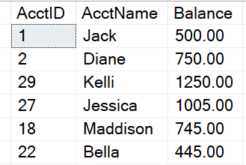
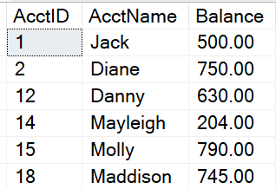
How Data is Stored in Data Pages
Heap
Data stored in a Heap is not stored in any order and normally does not have a Primary Key.
Clustered Index
Clustered Index data is stored in sorted order by the Clustering key. In many cases, this is the same value as the Primary Key.

Slide 8
Heap
A heap is a table without a clustered index
Unordered masses of data
Can be good for quickly importing large sets of data
Not a good idea for reporting-based data structures
Use the ALTER TABLE…REBUILD command to “rebuild” a heap table
Do not use a heap
When the data is frequently returned in a sorted order.
When the data is frequently grouped together.
When ranges of data are frequently queried from the table.
When there are no nonclustered indexes and the table is large.
Notes:
Key Points :
Heaps are typically a poor choice for production structures because:
Forwarding pointers.
8-byte Row-ID assigned on insert. RID consisting of the file number, data page number, and slot on the page.
Not great at all for table scans.
Sometimes expensive to find a spot where a row can be inserted.
Data pages are not linked, so sequential access needs to refer to the index allocation map (IAM) pages.
=============
More Information
=============
A heap is a table without a clustered index. One or more nonclustered indexes can be created on tables stored as a heap. Data is stored in the heap without specifying an order. Usually data is initially stored in the order in which the rows are inserted into the table, but the Database Engine can move data around in the heap to store the rows efficiently; so the data order cannot be predicted. To guarantee the order of rows returned from a heap, you must use the ORDER BY clause. To specify the order for storage of the rows, create a clustered index on the table, so that the table is not a heap.
When Not to Use a Heap
Do not use a heap when the data is frequently returned in a sorted order. A clustered index on the sorting column could avoid the sorting operation.
Do not use a heap when the data is frequently grouped together. Data must be sorted before it is grouped, and a clustered index on the sorting column could avoid the sorting operation.
Do not use a heap when ranges of data are frequently queried from the table. A clustered index on the range column will avoid sorting the entire heap.
Do not use a heap when there are no nonclustered indexes and the table is large. In a heap, all rows of the heap must be read to find any row.

Slide 9
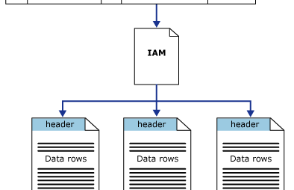
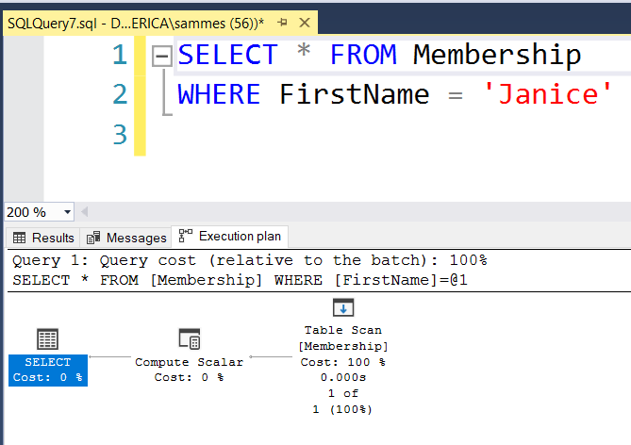
Heap Structures
Heaps have one row in sys.partitions, with index_id = 0 for each partition used by the heap
Notes:
Key Points:
Table scans or serial reads of a heap can be performed by scanning the IAM pages to find the extents that are holding pages for the heap.
Because the IAM represents extents in the same order that they exist in the data files, this means that serial heap scans progress sequentially through each file.
Using the IAM pages to set the scan sequence also means that rows from the heap are not typically returned in the order in which they were inserted.
Queries retrieving data from Heap objects will read all pages on that table. This is a very expensive operation.
=============
More Information
=============
The Diagram in slide illustrates how the SQL Server Database Engine uses IAM pages to retrieve data rows in a single partition heap.
Depending on the data types in the heap, each heap structure will have one or more allocation units to store and manage the data for a specific partition.
At a minimum, each heap will have one IN_ROW_DATA allocation unit per partition.
The heap will also have one LOB_DATA allocation unit per partition, if it contains large object (LOB) columns.
It will also have one ROW_OVERFLOW_DATA allocation unit per partition, if it contains variable length columns that exceed the 8,060 byte row size limit.
The column first_iam_page in the sys.system_internals_allocation_units system view points to the first IAM page in the chain of IAM pages that manage the space allocated to the heap in a specific partition.
SQL Server uses the IAM pages to move through the heap.

Slide 10
Clustered Indexes
An ordered data structure that is implemented as a Balanced (B) Tree.
When a table is clustered, the leaf level of the index contains ALL data in the table. This means that the clustered index IS the table. This is also why there is only one per table.
The leaf level of the clustered index contains data pages.
Notes:
Clustered Index
Implemented as an Inverted Balanced (B) Tree, or B-Tree.
The top of the B-Tree contains the ROOT Level. Contains range of key values and indication of location for those key ranges.
Intermediate Level(s) are located below Root Level
Contain finer grain key distribution.
Number of Intermediate levels is proportional to Cluster Key width, and the number of rows.
A small Clustered Table may not have Root or Intermediate level(s).
Leaf Level contains the actual data pages.

Slide 11
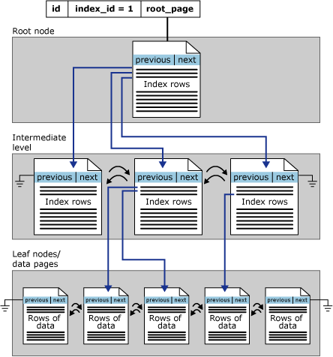
Clustered Index Structure
Leaf Node Contains Data Pages

Slide 12

Demonstration
Examining index metadata and Building a B-Tree
This demonstration reviews index, partition, and allocation unit metadata.
Show how a B-Tree begins to form as rows are added to a table.
Notes:
M05L01Demo01
Consider demoing the following: E:\Demos\M05L01Demo01\Examine_Index_MetaData.sql
Consider demoing the following: E:\Demos\M05L01Demo01\Building_a_B-Tree.sql

Slide 13
Non-Clustered Indexes
Same B-tree data structure as a clustered index.
It is a separate structure built on top of a Heap or Clustered Index.
Only contains a subset of the columns in the base table
The leaf level contains only the columns defined in the index as well as the clustered key/heap ID that points to the base table structure.
Notes:
NonClustered Index
Same B-tree data structure as in a clustered index, except for Leaf Level.
Non-Clustered Index Data is kept in synch with base table, but its data is stored separately.
Contains a subset of the columns in the base table.
Think of it as a skinny table that is really fast for searching and sorting.
Most likely far fewer pages in a NC index as compared to a Clustered table.
Leaf level contents:
Columns defined in the index key.
A ‘pointer’ to link back to the base table (to retrieve additional data).
clustered key for Clustered Objects or
ROW ID for heap objects
Any Included Columns
As Leaf level contains fewer columns in comparison to base table, Non-Clustered indexes have fewer pages than the corresponding base table.
References https://docs.microsoft.com/en-us/sql/relational-databases/sql-server-index-design-guide?view=sql-server-ver15

Slide 14

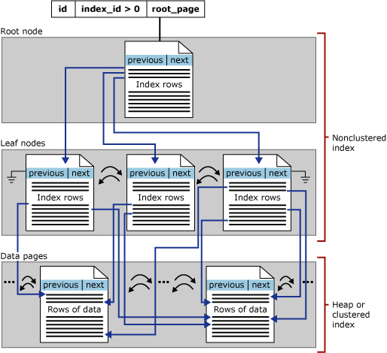
Non-Clustered Index Structure
Leaf Node has Pointers to Base Table
Base Table (Heap or Clustered Index

Slide 15
Clustered vs Nonclustered Indexes
An index is an on-disk structure associated with a table or view that speeds retrieval of rows.
Clustered Indexes
Leaf level has data rows stored with index.
Non-clustered Indexes
Separate structure from base table.
Contains a pointer back to base table called:
“Skinny” data structure as it contains a subset of base table only.
To by-pass index key limits (1,700 bytes) ,non-key columns can be added to leaf level.
As Leaf level contains fewer columns than base table, the non-clustered index uses fewer pages than the corresponding base table.
Row ID (RID when base table is HEAP)
Key (KEY when base table is Clustered)
Table data can be sorted in only one way.
Defines the order in which data is physically stored in a table.
When a table has a clustered index, the object is called clustered table.
Cluster key is added to nonclustered index (as the pointer), keep it as narrow as possible.
Notes:
Clustered
Clustered indexes sort and store the data rows in the table or view based on their key values. These are the columns included in the index definition. There can be only one clustered index per table, because the data rows themselves can be stored in only one order.
The only time the data rows in a table are stored in sorted order is when the table contains a clustered index. When a table has a clustered index, the table is called a clustered table. If a table has no clustered index, its data rows are stored in an unordered structure called a heap.
Nonclustered
Nonclustered indexes have a structure separate from the data rows. A nonclustered index contains the nonclustered index key values and each key value entry has a pointer to the data row that contains the key value.
The pointer from an index row in a nonclustered index to a data row is called a row locator. The structure of the row locator depends on whether the data pages are stored in a heap or a clustered table. For a heap, a row locator is a pointer to the row. For a clustered table, the row locator is the clustered index key.
You can add non-key columns to the leaf level of the nonclustered index to by-pass existing index key limits, and execute fully covered, indexed, queries. For more information, see Create Indexes with Included Columns. For details about index key limits see Maximum Capacity Specifications for SQL Server.
Both clustered and nonclustered indexes can be unique. This means no two rows can have the same value for the index key. Otherwise, the index is not unique and multiple rows can share the same key value. For more information, see Create Unique Indexes.
Indexes are automatically maintained for a table or view whenever the table data is modified.
See Indexes for additional types of special purpose indexes.
References : https://docs.microsoft.com/en-us/sql/relational-databases/indexes/clustered-and-nonclustered-indexes-described?view=sql-server-ver15

Slide 16
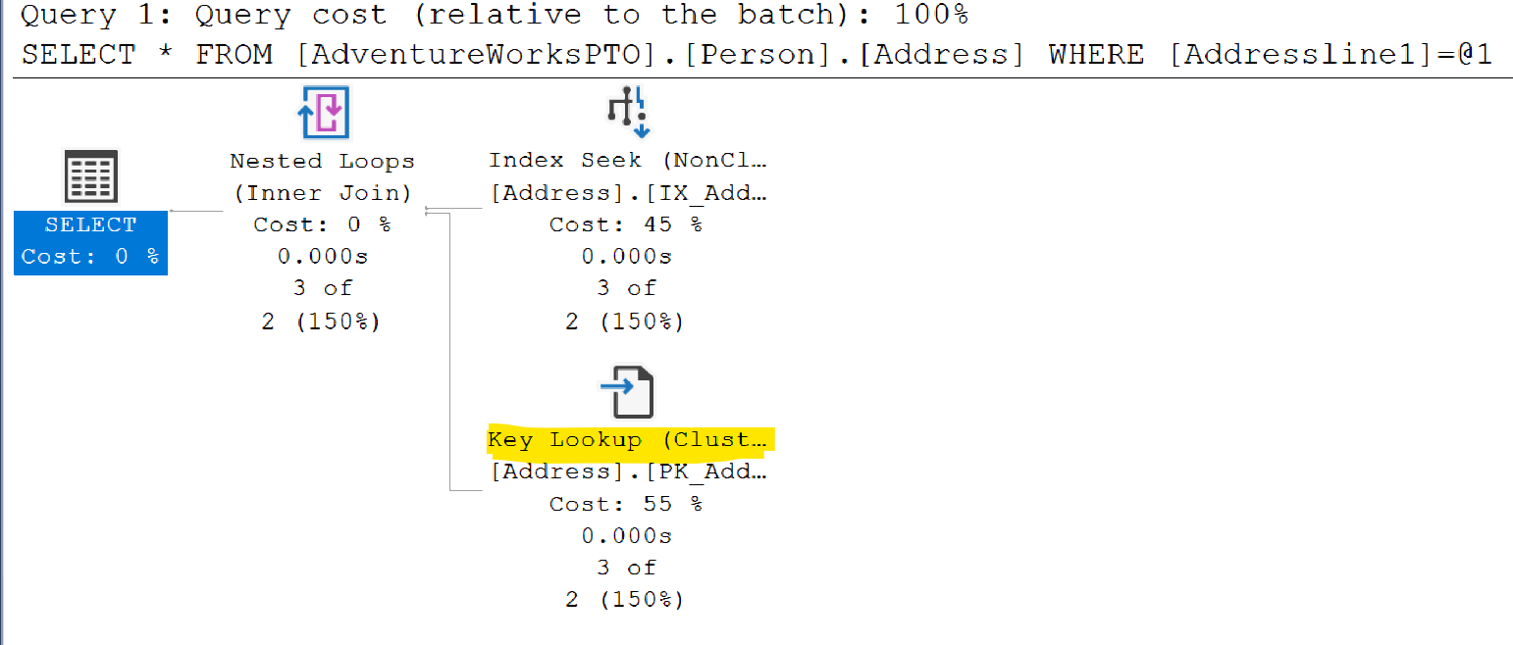
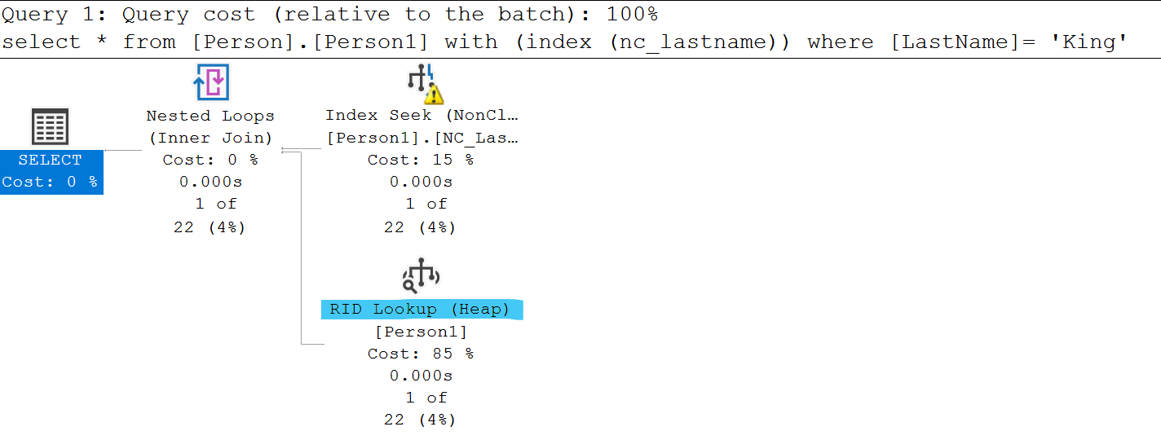
Bookmark Lookup or RID lookup
Occurs when SQL uses a nonclustered index to satisfy all or some of a query’s predicates, but it doesn’t contain all the information needed to cover the query.
Lookup effectively join the nonclustered index back to the clustered index or heap.
If table has clustered index, it is called bookmark lookup (or key lookup)
If the table is a heap with a non-clustered index, it is called RID lookup
This is an expensive operation.
Notes:
Key Points:
When nonclustered indexes are used, SQL Server may choose to use a different access method.
When the nonclustered index is sought or scanned, it is doing so to support WHERE clauses and JOINs.
However, the nonclustered index often cannot support the SELECT clause hence need to join with base table.
To put it another way, it cannot ‘cover’ the query.
=============
More Information
=============
To get the columns needed for the select clause, SQL Server needs to look up those additional columns using a Key Lookup, which reaches back to the clustered index or heap.
This is possible because each row in the nonclustered index has not only the columns that were defined, but also includes the clustering key or RID.
When the nonclustered index seek/scan finds the rows that match the filter requested, it loops over each of the rows, gets the hidden key/RID, and gets the additional columns needed.
Key lookups are costly. In fact, they are so costly that SQL Server frequently decides that the cost of a nonclustered index seek + lookup is higher than simply scanning the clustered index.
To improve Query performance one must remove the lookup from the Execution plan.
The ‘tipping point’ that determines when SQL Server will scan is pretty low, and is typically 10%.
Therefore, avoiding key lookups is often a good way to help query performance. The next lesson, “Indexing Strategy”, discusses ways that this can be done.

Slide 17
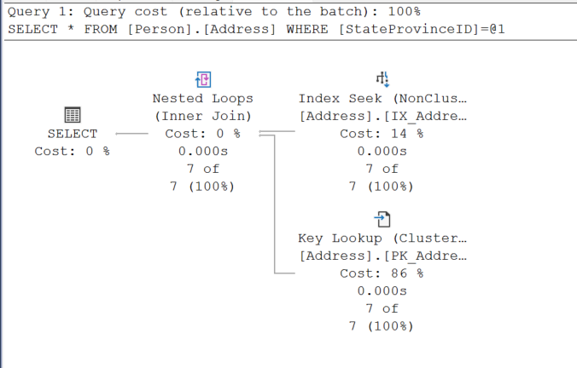
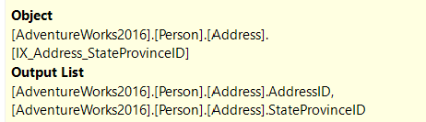

Key Lookup
Notes:
Key Points:
When nonclustered indexes are used, SQL Server may choose to use a different access method.
When the nonclustered index is sought or scanned, it is doing so to support WHERE clauses and JOINs.
However, the nonclustered index often cannot support the SELECT clause hence need to join with base table.
To put it another way, it cannot ‘cover’ the query.
=============
More Information
=============
To get the columns needed for the select clause, SQL Server needs to look up those additional columns using a Key Lookup, which reaches back to the clustered index or heap.
This is possible because each row in the nonclustered index has not only the columns that were defined, but also includes the clustering key or RID.
When the nonclustered index seek/scan finds the rows that match the filter requested, it loops over each of the rows, gets the hidden key/RID, and gets the additional columns needed.
Key lookups are costly. In fact, they are so costly that SQL Server frequently decides that the cost of a nonclustered index seek + lookup is higher than simply scanning the clustered index.
To improve Query performance one must remove the lookup from the Execution plan.
The ‘tipping point’ that determines when SQL Server will scan is pretty low, and is typically 10%.
Therefore, avoiding key lookups is often a good way to help query performance. The next lesson, “Indexing Strategy”, discusses ways that this can be done.

Slide 18
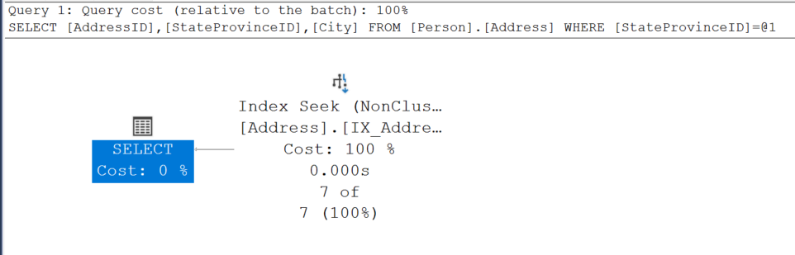
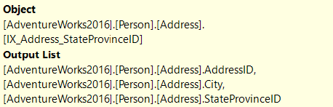
Non-Clustered Index with Included Column
Notes:
Key Points:
When nonclustered indexes are used, SQL Server may choose to use a different access method.
When the nonclustered index is sought or scanned, it is doing so to support WHERE clauses and JOINs.
However, the nonclustered index often cannot support the SELECT clause hence need to join with base table.
To put it another way, it cannot ‘cover’ the query.
=============
More Information
=============
To get the columns needed for the select clause, SQL Server needs to look up those additional columns using a Key Lookup, which reaches back to the clustered index or heap.
This is possible because each row in the nonclustered index has not only the columns that were defined, but also includes the clustering key or RID.
When the nonclustered index seek/scan finds the rows that match the filter requested, it loops over each of the rows, gets the hidden key/RID, and gets the additional columns needed.
Key lookups are costly. In fact, they are so costly that SQL Server frequently decides that the cost of a nonclustered index seek + lookup is higher than simply scanning the clustered index.
To improve Query performance one must remove the lookup from the Execution plan.
The ‘tipping point’ that determines when SQL Server will scan is pretty low, and is typically 10%.
Therefore, avoiding key lookups is often a good way to help query performance. The next lesson, “Indexing Strategy”, discusses ways that this can be done.

Slide 19
Included columns for non-clustered indexes
Included as additional non-key columns of data in the leaf level.
Allows for covering more queries.
As query optimizer can locate column values in index (leaf level) hence performance gain is achieved.
Not restricted to a Maximum of 32 key columns and index key size of 1,700 bytes.
(n)varchar(max) can be used, but not (n)text or image data types.
Index search is not permitted on non-key columns.
Notes:
Key Points:
By including non-key columns, you can create nonclustered indexes that cover more queries.
This is because the non-key columns have the following benefits:
They can be data types not allowed as index key columns.
They are not considered by the Database Engine when calculating the number of index key columns or index key size.
An index with non-key columns can significantly improve query performance when all columns in the query are included in the index either as key or non-key columns.
Performance gains are achieved because the query optimizer can locate all the column values within the index; table or clustered index data is not accessed resulting in fewer disk I/O operations.
=============
More Information
=============
include non-key columns in a nonclustered index to avoid exceeding the current index size limitations of a maximum of 32 key columns and a maximum index key size of 1,700 bytes (16 key columns and 900 bytes prior to SQL Server 2016 (13.x)). The Database Engine does not consider non-key columns when calculating the number of index key columns or index key size.
References : https://docs.microsoft.com/en-us/sql/relational-databases/indexes/create-indexes-with-included-columns?view=sql-server-ver15

Slide 20
Demonstration
Access Methods
Demonstrate seeks, scans, and lookups
Notes:
M05L01Demo02
Consider demoing the following: E:\Demos\M05L01Demo02\AccessMethods.sql

Slide 21

Questions?

Slide 22
Knowledge Check
What are the three access methods reviewed in this lesson?
What are the three different types of allocations?
What is the primary goal of indexing?
Notes:
Answer 1: The three access methods are:
Scans, which read all the data.
Seeks, which read parts of the data by traversing the B-tree to find exactly where to start and stop.
Lookups, which get the columns needed in the select clause when a nonclustered index cannot cover.
Answer 2: In row data, which holds ints, datetimes, and other basic data types.
Strings can be stored in-row data when they fit in the page.
Row overflow data holds strings that are too large to fit in-row data.
LOB data , such as xml, varbinary(max), and varchar(max).
Answer 3: The primary goal of indexing is to reduce logical reads.

Slide 23
Lesson 2: Index Strategy

Slide 24
Objectives
After completing this learning, you will be able to:
Describe best practices associated with clustered index design.
Consider factors involved in designing a nonclustered indexing strategy.
Explain how an indexing strategy can reduce logical reads.
Describe use of Filter indexes and Indexed views.
Explain the role of Fill factor.
Use a technique to reduce the fragmentation.
Apply Index Compression.

Slide 25
Characteristics of a Good Clustering Key
Narrow
Unique
Static
Increasing
Use a data type with a small number of bytes to conserve space in tables and indexes
To avoid SQL adding a 4-byte uniquifier
Allows data to stay constant without constant changes which could lead to page splits
Allows better write performance and reduces fragmentation issues

Slide 26
Best Practices for Clustered indexes
The primary goal of any indexing strategy is to make queries faster
Best Practice | Seeks, not scans | Avoid key lookups | Get most rows on the index page | Get most rows on the data page | Avoid page splits
Use frequently searched value | X | X
Use narrow keys |  |  | X | X
Use unique values |  |  | X | X
Use static values |  |  |  |  | X
Use ascending or descending key |  |  |  |  | X
Notes:
Key Notes:
The primary goal of any indexing strategy is to make queries faster.
Indexes should be present on columns that support the following operations:
Joins
Filtering in the WHERE clause
The ORDER BY clause
=============
More Information
=============
This lesson on indexing strategy is, ultimately, about ways in which indexes can be optimized to ensure that logical reads are minimized, and that those reads are sequential rather than random. The techniques discussed are varied, so it is important to keep these goals in mind.
Best practices for clustered indexes all support the primary or secondary goals of indexing.
The most critical aspect of clustered index design is to select a column that is the most frequently searched for specific values. By doing so, you help ensure that the most common column used to access the table is how the data is sorted, which avoids key lookups and helps ensure that scans will not be needed.
Remember that joins are a common way to search for specific values.
Use narrow keys to ensure that B-trees have as few intermediate levels as possible. This speeds up seeks by reducing the levels of the B-tree that need to be traversed. This also helps nonclustered index seeks, because the clustering key is embedded in the nonclustered index. Another benefit of a narrow clustering key is that the leaf level of nonclustered indexes will store less data per row, which results in fewer pages needed, thereby reducing logical reads when the nonclustered indexes are scanned.
Clustered indexes have to be unique, whether you define them as such or not. If duplicate values are inserted, Microsoft SQL Server inserts a hidden extra column called a uniquifier – a 4 byte int – in those duplicated rows.
This causes the clustering key to be wider, with all the impact just listed above. If you have a lot of duplication, consider adding a second column to the clustering key. You will still have a wider key, but because that column will be embedded in all of the nonclustered indexes, you may be able to cover more queries. If the duplication is minimal, though, adding another column to the key would not be worth it.
If you cluster on a value that gets updated, SQL Server will have to spend time moving the entire row to new locations. If the table has 75 columns, that is a lot of movement, which takes time. Also, the movement causes page splits. Page splits cause fragmentation, which affects scans because data cannot be read sequentially.
Clustering on values that are not naturally ascending or descending also increase page splits.
References
https://docs.microsoft.com/en-us/archive/blogs/josebda/sql-server-2008-indexing-best-practices

Slide 27
Clustered Index vs Primary key considerations
Frequently, clustering on the primary key supports the clustered index best practices
Primary keys are involved in joins to foreign keys
Primary keys are unique
Primary keys are typically ascending
Primary keys are typically not updated
Do not cluster on the Primary key IF:
When table is accessed by other keys than the primary key
Query predicate use Primary Key
Common issue accessing association or child table, when these tables require different primary key than parent table
Use sys.dm_db_index_usage_stats to review data access patterns of index
Notes:
Key Points:
Primary keys are involved in joins to foreign keys, which typically means that you are frequently accessing the data via primary key values.
Frequently, clustering on the primary key supports the clustered index best practices.
Even if primary key meets all the other best practices, if the data is not searched by the primary key, then it is the wrong clustering key.
=============
More Information
=============
Many people associate clustering keys with primary keys and may not be aware that the two are independent concepts.
A primary key simply ensures that each row is unique. It has nothing to do with the way that the data in a table is sorted.
Because they are independent, it is not a requirement that the same key(s) be used for both.
So, why is it such a common practice?
The answer is that a lot of the time, it makes a lot of sense. Primary keys satisfy a lot of clustered index best practices.
In a one-to-many child table, you would typically use parent_id, child_id.
Do not cluster on the Primary key
This is a common problem with association tables and child tables in a one-to-many relationship, in which the typical access is via the parent table’s ID.
If usage stats DMV show little to no index seeks on the clustered key, but a large number of index seeks on the parent ID with key lookups on the clustered index, that is a sign that the clustered key may need to change to the parent ID.
The parent ID is a good choice not only because it is the primary access path to the table. It is also typically ascending, so the rate of fragmentation is likely to be reasonably low.
It often will not be unique, so adding a second column to guarantee uniqueness may be a good idea. In an association table, creating a clustered index on parent1_id, parent2_id works well.

Slide 28
Non-Clustered Index Strategy
Index columns used in WHERE clauses and JOINs.
Keep indexes to a minimum, to minimize impact on DML and log writes.
Two basic approaches: Single column indexes or Multicolumn indexes
Easy to create too many nonclustered indexes.
Specific indexes are appropriate for high-impact queries.
Ideally the focus should be writing queries to use existing indexes, rather than on adding more indexes.
Notes:
Key Points:
Index columns used in WHERE clauses and JOINs
Start with foreign keys, and remove later if not used
This strategy is easy for nonclustered indexes, for any single query. Build an index to support joins and WHERE clauses, and you are done. The challenge comes when you need to address indexing a table with a lot of different queries used against it, each of which may filter on different combinations of columns.
You cannot build specific indexes for every combination of fields that may ever be used, because:
Of storage issues.
A lot of nonclustered indexes would impact DML.
Of the increased maintenance overhead.
=============
More Information
=============
Deciding on an indexing strategy is never easy and is never a one-time effort.
The queries against a table change over time, and therefore, indexing strategies have to be reviewed and adjusted as needed.
Ideally, the first column in a multi-column index will be used in every query. However, that is not likely to happen.
One solution is to create every possible combination of indexes, but that will not scale.
Even though index scans are not as efficient as seeks, the fact is that nonclustered indexes only have a few columns as compared to the clustered index, which could have dozens of columns.
This means that scanning a nonclustered index to find records may result in acceptable query performance.
Ideally the focus should be on writing queries to use existing indexes, rather than on adding more indexes

Slide 29
Single Vs Multi-column indexes
Single-column Indexing
Good choice for columns that are highly selective, or columns referenced often by criteria.
Multi-Column Indexing
Good choice for low cardinality columns.
Highest cardinality field first, to zoom into a narrow range of the B-Tree as quickly as possible.
Equality columns before inequality columns.
When filtering data from table with multiple single column indexes, SQL uses the index with higher cardinality column, it may be better to not index the low cardinality column.
Notes:
Key Notes:
Single Column Index: If the columns to be indexed have a lot of distinct values (and so return a small rowset for any one value that is searched), then creating separate, single-column indexes works well.
However, if SQL has to pull large amounts of data from the single-column indexes, that is going to involve a lot of logical reads, even If SQL Server ends up returning a small rowset.
Multi-column Index: if the final rowset of 2 or more low cardinality fields is a small result set, then having a single multi-column index may significantly reduce the total logical reads and the processing time, because SQL Server does not have to read 2 large result sets independently, and then join the results together. It can reduce CPU or memory costs.
The cardinality of all the columns together is higher than any one column alone
However, multi-column indexing has a couple of challenges. First, you need to choose column order. SQL Server traverses the B-Tree based on the order specified. Therefore, indexes on Col1, Col2, and Col2, Col1 are not equivalent. This means that you can end up wanting to create a bunch of different
multi-column indexes, which will not scale well.
=============
More Information
=============
Single Column Index:
The idea behind single column indexing approaches is that SQL Server can satisfy filters against multiple columns by searching each index separately, and then joining the results together to get the rows that satisfy all the filters.
As an example, imagine that you have 100 million orders, and you have 3 payment types (case, check, and charge) and 2 order types (online and in store).
If you have separate indexes for each column, then SQL Server needs to retrieve approximately 33 million rows that match the payment type filter, and 50 million rows to match the order type filter. That is a lot of logical I/O for each.
Then, SQL has to merge those result sets together, and this takes a lot of CPU and memory to return the 10 million rows that match both.
In such a situation, you would be better off with a multi-column index.
Multi Column Index:
Continuing the example from the previous slide, if a 2-column index is created on payment type and order type, SQL Server is still going to have a lot of I/O. When you are getting 10 million rows, that is inevitable.
However, now SQL Server can find the matching rows in a single pass of 1 index, meaning that you have a smaller number of logical reads (reads to find the 10 million rows, rather than the reads to find 33 million and 50 million rows) and you have no need to merge result sets together.
Therefore, there are no CPU or memory costs. Is this a fast query? Probably not. Is it faster and less resource-intensive than the single-column approach? Definitely.

Slide 30
Multi-Column Indexing Access
Seek only happens if you search for the columns in the specified order.
Effect of column in different WHERE clause.
WHERE PostalCode = 98011 – seek
WHERE PostalCode = 98011 – seek AND City = Bothell -- scan
WHERE StateID = 79 -- scan
CREATE INDEX IX1 ON TABLE (PostalCode, StateID, City)
WHERE PostalCode = 98011 AND StateID = 79 – seek both
Notes:
When trying to decide whether your index should be on Col1, Col2 or Col2, Col1 (or both), remember that even though SQL Server performs best when it can seek the index, scanning the index may still perform a lot better than scanning the clustered index.
That Is because the clustered index holds all the data for the rows and is therefore typically much larger than any nonclustered index, which typically only has a few columns.
Therefore, if you are frequently searching for Col1 or Col1, Col2, and only occasionally searching for Col2, it may be OK to accept the index scan needed when you do query Col2 alone, instead of creating both indexes and incurring that maintenance and DML overhead.

Slide 31
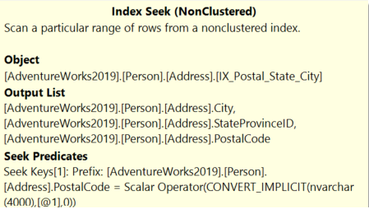
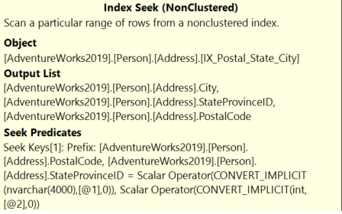
Multi-Column Indexing Access (Seek Predicates)
--Single value performs Index Seek.
SELECT City, StateProvinceID, PostalCode
FROM Person.Address
WHERE PostalCode = '98011'
--Index Seek on both columns
--Search condition in same order as Index.
SELECT City, StateProvinceID, PostalCode
FROM Person.Address
WHERE PostalCode = '98011' AND StateProvinceID = 79
Notes:
When trying to decide whether your index should be on Col1, Col2 or Col2, Col1 (or both), remember that even though SQL Server performs best when it can seek the index, scanning the index may still perform a lot better than scanning the clustered index.
That Is because the clustered index holds all the data for the rows and is therefore typically much larger than any nonclustered index, which typically only has a few columns.
Therefore, if you are frequently searching for Col1 or Col1, Col2, and only occasionally searching for Col2, it may be OK to accept the index scan needed when you do query Col2 alone, instead of creating both indexes and incurring that maintenance and DML overhead.

Slide 32
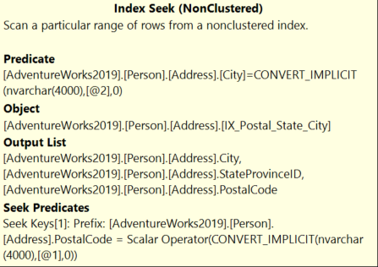
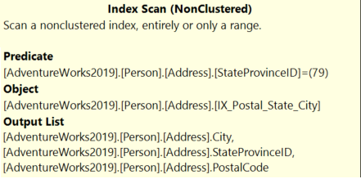
Multi-Column Indexing Access (Scan Predicates)
--Search condition not in same order as Index.
--Performs Index Scan.
SELECT City, StateProvinceID, PostalCode
FROM Person.Address
WHERE StateProvinceID = 79
--Index Seek on first column
--After seek, will scan second column
SELECT City, StateProvinceID, PostalCode
FROM Person.Address
WHERE PostalCode = '98011' AND City = 'Bothell'
Notes:
When trying to decide whether your index should be on Col1, Col2 or Col2, Col1 (or both), remember that even though SQL Server performs best when it can seek the index, scanning the index may still perform a lot better than scanning the clustered index.
That Is because the clustered index holds all the data for the rows and is therefore typically much larger than any nonclustered index, which typically only has a few columns.
Therefore, if you are frequently searching for Col1 or Col1, Col2, and only occasionally searching for Col2, it may be OK to accept the index scan needed when you do query Col2 alone, instead of creating both indexes and incurring that maintenance and DML overhead.

Slide 33
Demonstration
Analyzing Index Usage
Show how index usage patterns can help identify index and query improvements.
Notes:
M05L05Demo01
Consider demoing the following: E:\Demos\M05L05Demo01\IndexUsage.sql

Slide 34
Questions?

Slide 35
Lesson 3: Partitioned Tables and Indexes

Slide 36
Objectives
After completing this learning, you will be able to:
Understand Partition Concepts.
Explain benefits of partitioning.
Distinguish between aligned vs non-aligned indexes.
Manage partitions.
Apply Partition performance guidelines.

Slide 37
What is Partitioning?
“Horizontal Partition”
Table or Index Partition
Breaking a single table or index into multiple HoBT ( Heap or B-Tree) structures
Requires a single column to use as partition key
Partitioning is transparent to all queries
Notes:
Key Points:
Vertical partitions are created manually by segments columns into multiple tables containing a subset of the columns from the original table
you can improve performance by enabling lock escalation at the partition level instead of a whole table.
Per-Partition management options : Index Maintenance ,Lock Escalation, Compression
=============
More Information
=============
Taking Advantage of Multiple Disk Drives
It may be tempting to map your partitions to filegroups, each accessing a different physical disk drive, in order to improve I/O performance. When SQL Server performs data sorting for I/O operations, it sorts the data first by partition. Under this scenario, SQL Server accesses one drive at a time, and this might reduce performance. A better solution in terms of performance is to stripe the data files of your partitions across more than one disk by setting up a RAID. In this way, although SQL Server still sorts data by partition, it can access all the drives of each partition at the same time. This configuration can be designed regardless of whether all partitions are in one filegroup or multiple filegroups.
For more information about how SQL Server works with different RAID levels, Controlling Lock Escalation Behavior
Partitioning tables can improve performance by enabling lock escalation to a single partition instead of a whole table. To reduce lock contention by allowing lock escalation to the partition, use the LOCK_ESCALATION option of the ALTER TABLE statement.
References
http://msdn.microsoft.com/en-us/library/ms177411(v=SQL.105).aspx
https://docs.microsoft.com/en-us/sql/relational-databases/partitions/partitioned-tables-and-indexes

Slide 38
Partitioning benefits
Data Access
Faster data load and offload.
Query performance may be improved:
Piecemeal backup / restore of data by partition.
Per-Partition management available for:
Index Maintenance
when predicate uses Partition-Key → partition elimination
when predicate doesn’t use partition key → parallel execution
Maintenance and management
Data placement handled by SQL Server.
Lock Escalation
Compression

Slide 39
Horizontal Partitioning
Table without
Partition
ProductKey | OrderDateKey | CustomerKey | SalesOrderNumber | UnitPrice | ExtendedAmount | ProductStandardCost
312 | 20050922 | 28191 | SO44236 | 3578.27 | 3578.27 | 2171.2942
313 | 20050923 | 28163 | SO44242 | 3578.27 | 3578.27 | 2171.2942
314 | 20050926 | 28142 | SO44254 | 3578.27 | 3578.27 | 2171.2942
312 | 20050927 | 28171 | SO44259 | 3578.27 | 3578.27 | 2171.2942
Partition Key
Partition 1
ProductKey | OrderDateKey | CustomerKey | SalesOrderNumber | UnitPrice | ExtendedAmount | ProductStandardCost
312 | 20050922 | 28191 | SO44236 | 3578.27 | 3578.27 | 2171.2942
313 | 20050923 | 28163 | SO44242 | 3578.27 | 3578.27 | 2171.2942
Table with Partition
Partition 2
ProductKey | OrderDateKey | CustomerKey | SalesOrderNumber | UnitPrice | ExtendedAmount | ProductStandardCost
314 | 20050926 | 28142 | SO44254 | 3578.27 | 3578.27 | 2171.2942
312 | 20050927 | 28171 | SO44259 | 3578.27 | 3578.27 | 2171.2942

Slide 40
Table Partitioning Concepts
Partition Function
Defines how the table is logically partitioned.
Defines data type of partition key, and ranges of each partition.
Ranges can be modified as needed.
Partition Schemes
Specify mapping from partitioned table to Filegroup(s).
Uses Partition Function to perform mapping.
Partition Table & index
Partitioned Tables are defined using Partition Schemes.
Several tables may share common Partition Functions and Partition Schemes.
Loading data into the table or index creation, will move data to correct partition automatically.
Partition Column (key)
Column used to apply partition function.
If using a computed column, it must be explicitly marked as PERSISTED.
Different filegroups can provide increased performance, but is not required.
Notes:
Key Points:
Partition Function
Ranges of each partition can either be Range Right vs. Range Left.
Partition ranges can be modified over the time, but Partition Function data type cannot be modified.
Number of partitions = number of boundary values + 1.
A boundary value can exist in only one partition.
Range LEFT means that the boundary value falls into the left partition. Right means it falls into the right partition.
Partition Schemes
Associates each partition defined by a partition function with a storage location (Filegroup).
No requirement to use different filegroups for different partitions.
BUT using different filegroups is useful for filegroup-based backup or storage location.
Best Practice: Spread all Filegroups in a Partition Scheme across as many disk spindles as possible.
Partition Table
Data is now automatically partitioned.
Loading the table will distribute the data to its partitions.
Best Practice: When designing partition functions and schemes, plan to keep the rightmost and leftmost FGs empty.

Slide 41
Aligned vs Non-aligned indexes
Aligned Index
An index that is built on the same partition scheme as its corresponding table.
When a table and its indexes Align, SQL Server can switch partitions quickly and efficiently.
Non-aligned index
An index partitioned independently from its corresponding table.
Designing a non-aligned partitioned index can be useful in the following cases:
The base table has not been partitioned.
The index key is unique, and it does not contain the partitioning column of the table.
Useful when want to joins with more tables using different join columns.
Notes:
Aligned index
An index that is built on the same partition scheme as its corresponding table.
When a table and its indexes are in alignment, SQL Server can switch partitions quickly and efficiently while maintaining the partition structure of both the table and its indexes.
An index does not have to participate in the same named partition function to be aligned with its base table.
However, the partition function of the index and the base table must be essentially the same, in that:
The arguments of the partition functions have the same data type.
They define the same number of partitions.
They define the same boundary values for partitions.
Non-aligned index
An index partitioned independently from its corresponding table. That is, the index has a different partition scheme or is placed on a separate filegroup from the base table. Designing a non-aligned partitioned index can be useful in the following cases:
The base table has not been partitioned.
The index key is unique and it does not contain the partitioning column of the table.
You want the base table to participate in collocated joins with more tables using different join columns.
References:
https://docs.microsoft.com/en-us/sql/relational-databases/partitions/partitioned-tables-and-indexes?view=sql-server-ver15

Slide 42
Indexes on Partitioned Table
Indexes are logically aligned when they use partitioning column.
Storage Alignment
By default, indexes will be created ON the partition scheme – ‘storage aligned’ indexes.
Logical Alignment
Indexes are storage aligned when created on the same partitioning scheme.
CREATE [CLUSTERED] INDEX … ON {partition_scheme_name ( column_name ) }
Notes:
Partitioning Clustered Indexes
When partitioning a clustered index, the clustering key must contain the partitioning column.
When partitioning a nonunique clustered index, and the partitioning column is not explicitly specified in the clustering key, SQL Server adds the partitioning column by default to the list of clustered index keys.
If the clustered index is unique, you must explicitly specify that the clustered index key contain the partitioning column.
By default, indexes will be created ON the partition scheme – “storage aligned” indexes:
Each index’s partition is stored on the same filegroup as its partition.
Important to do this if you plan on altering the partition function.
Partitioning NonClustered Indexes
When partitioning a unique nonclustered index, the index key must contain the partitioning column.
When partitioning a nonunique, nonclustered index, SQL Server adds the partitioning column by default as a non-key (included) column of the index to make sure the index is aligned with the base table.
SQL Server does not add the partitioning column to the index if it is already present in the index.

Slide 43
Partitioned table and index sample
-- Creating a partition function with four partitions
CREATE PARTITION FUNCTION myRangePF1 (int)
AS RANGE LEFT FOR VALUES (1, 100, 1000) ;
GO
-- Creates a partition scheme that applies myRangePF1 to the four filegroups
CREATE PARTITION SCHEME myRangePS1
AS PARTITION myRangePF1
TO (test1fg, test2fg, test3fg, test4fg) ;
GO
-- Creates a partitioned table that uses myRangePS1 to partition col1
CREATE TABLE PartitionTable (col1 int NOT NULL, col2 char(10))
ON myRangePS1 (col1) ;
GO
CREATE CLUSTERED INDEX ClusIndxCol1 ON PartitionTable(col1)
ON myRangePS1(col1)
GO
Notes:
References
https://docs.microsoft.com/en-us/sql/relational-databases/partitions/create-partitioned-tables-and-indexes?view=sql-server-ver15

Slide 44
Table Partitioning Operations
Data Movement in table or Partition is done using ALTER …SWITCH/MERGE/SPLIT
SWITCH
Uses staging table
MERGE
Used to eliminate an empty partition, by merging it with another partition
SPLIT
Used to create a new empty partition from an existing partition
MUST have same schema as Partitioned table
--SWITCH
ALTER TABLE PartitionTable SWITCH PARTITION 2 TO NonPartitionTable ;
--SPLIT
CREATE PARTITION FUNCTION myRangePF1 (int) AS RANGE LEFT FOR VALUES ( 1, 100, 1000 );
ALTER PARTITION FUNCTION myRangePF1() SPLIT RANGE (500);
--MERGE
CREATE PARTITION FUNCTION myRangePF1 (int) AS RANGE LEFT FOR VALUES ( 1, 100, 1000 );
ALTER PARTITION FUNCTION myRangePF1() MERGE RANGE (100);
Notes:
Key Notes:
SWITCH Requirements
There are numerous requirements for the SWITCH command.
For example,
The switched tables must have the same column structure and indexes, even the same foreign key constraints.
Source and target tables must share the same filegroup.
The target/receiving table (or partition) must be empty.
=============
More Information
=============
General Requirements for Switching Partitions
When a partition is transferred, the data is not physically moved; only the metadata about the location of the data changes. Before you can switch partitions, several general requirements must be met:
Both tables must exist before the SWITCH operation.
The table from which the partition is being moved (the source table) and the table that is receiving the partition (the target table) must exist in the database before you perform the switch operation.
The receiving partition must exist, and it must be empty.
Whether you are adding a table as a partition to an already existing partitioned table, or moving a partition from one partitioned table to another, the partition that receives the new partition must exist and it must be an empty partition.
The receiving nonpartitioned table must exist and it must be empty.
If you are reassigning a partition to form one nonpartitioned table, the table that receives the new partition must exist and it must be an empty nonpartitioned table.
Partitions must be on the same column.
If you are switching a partition from one partitioned table to another, both tables must be partitioned on the same column.
Source and target tables must share the same filegroup.
The source and the target table of the ALTER TABLE...SWITCH statement must reside in the same filegroup, and their large-value columns must be stored in the same filegroup. Any corresponding indexes, index partitions, or indexed view partitions must also reside in the same filegroup. However, the filegroup can be different from that of the corresponding tables or other corresponding indexes.
Source and target tables must not be replicated.
Neither the source table nor the target table can be sources of replication.
Triggers must not activate while moving partitions.
No INSERT, UPDATE, or DELETE triggers or cascading actions are activated by moving table partitions, and it is not required for the source or target tables to have similarly defined triggers to move partitions.
References:
SPLIT/MERGE Best Practices
Always keep empty partitions at both ends of the partition range.
Keep the partitions at both ends to guarantee that the partition split and the partition merge don't incur any data movement.
The partition split occurs at the beginning and the partition merge occurs at the end.
Avoid splitting or merging populated partitions.
Splitting or merging populated partitions can be inefficient.
They can be inefficient because the split or merge may cause as much as four times more log generation and may also cause severe locking.
References:
https://docs.microsoft.com/en-us/previous-versions/sql/sql-server-2008-r2/ms191160(v=sql.105)
https://docs.microsoft.com/en-us/sql/t-sql/statements/alter-table-transact-sql?view=sql-server-ver15
https://docs.microsoft.com/en-us/sql/t-sql/statements/alter-partition-function-transact-sql?view=sql-server-ver15

Slide 45
Demonstration
Partitioning
Explore Partition Schemes and Functions.
Notes:
M05L03Demo01
Consider demoing the following: E:\Demos\M05L03Demo01\PartitionTable.sql

Slide 46

SQL Server Partitioning
Practicing with a sliding partition window
Notes:
M05L03Lab01
Link to lab: Use electronic material to complete the lab exercise “Sliding Partition”

Slide 47
Questions?

Slide 48
Knowledge Check
What three structures are required to support partitions?
What are some benefits of partitioning?
What is used for data movement in partitions or table?
Notes:
Answer 1:
Partition schemes, partition functions and partition column
Answer 2:
Simplified data movement. With partition switches, data can be loaded into and out of tables easily. In addition, query performance can be improved when queries can eliminate partitions from consideration.
Answer 3:
Switch, Split, and Merge

Slide 49
Lesson 4: Index Monitoring and Fragmentation

Slide 50
Objectives
After completing this learning, you will be able to:
Monitor index usage.
Describe page splits.
Understand problems caused by page splits.
Monitor index fragmentation and free space.
Review options to remove fragmentation and free space.

Slide 51
Why to monitor Index usage
Data access and distribution changes over time.
By reviewing index usage, we can ensure that the indexes are appropriate for the current workload.
Use sys.dm_db_index_usage_stats and sys.dm_db_index_operational_stats to monitor index usage.
Database standard report also monitors Index usage and Physical Statistics.
Notes:
Key Points:
Understanding how indexes are used can help adjust indexing approaches in several ways.
You may find indexes that are not used, and be able to drop or disable them.
You may find clustered indexes that are scanned instead of sought, which could be fixed by adjusting the query.
You may find indexes that are used only at month end, and add them just when needed to reduce the impact on DML and index maintenance.
Sys.dm_db_index_usage_stats gives information about overall access methods to your indexes.
sys.dm_db_index_physical_stats DMF returns information about the lower-level I/O activities, like INSERT, UPDATE and DELETE operations, occurred on the index, per each table partition.
Database Reports
References: https://docs.microsoft.com/en-us/sql/relational-databases/system-dynamic-management-views/sys-dm-db-index-usage-stats-transact-sql?redirectedfrom=MSDN&view=sql-server-ver15

Slide 52
Clustered Index usage patterns
Pattern | Interpretation
Seeks, but no scans | May not need maintenance. Seeks are not impacted by fragmentation
Clustered index with High number of scans | Review missing index recommendations. Consider changing Clustering key. Simplify queries with complex WHERE clauses
Clustered index with Low number of seeks and high number of lookups | May need to change Clustering Key Look how often bookmark lookups occur.

Slide 53
Non-Clustered Index usage patterns
Pattern | Interpretation
Seeks, but no scans | May not need maintenance. Seeks are not impacted by fragmentation
Non-Clustered index with High number of scans | Consider compression. Check for non-SARGable queries. Review missing index recommendations
Index with No/low usage | May be able to drop or disable index
Non-Clustered Index Used at specific times only | May be able to drop index, recreate when needed

Slide 54
sys.dm_db_index_usage_stats
Tracks seeks, scans, and lookups
Provides date of last access
Counters are incremented once per query execution
User and system access (such as index rebuilds) are tallied separately
Counters are initialized to at SQL Server (MSSQLSERVER) service is restarts
SELECT
Distinct OBJECT_NAME(Indx.OBJECT_ID) Table_Name ,Indx.name IndexName
,Indx.type_desc IndexType,Iusg.user_seeks Seeks,Iusg.user_scans Scans
,Iusg.user_lookups Lookups ,Iusg.user_updates Updates ,Iusg.last_user_seek LastSeek
,Iusg.last_user_scan LastScan,Iusg.last_user_lookup LastLookup ,Iusg.last_user_update LastUpdate
FROM
SYS.INDEXES Indx
INNER JOIN SYS.DM_DB_INDEX_USAGE_STATS Iusg
ON Iusg.index_id = Indx.index_id AND Iusg.OBJECT_ID = Indx.OBJECT_ID
INNER JOIN SYS.DM_DB_PARTITION_STATS PrtSts
ON PrtSts.object_id=Indx.object_id
WHERE
OBJECTPROPERTY(Indx.OBJECT_ID,'IsUserTable') = 1
Notes:
Key Points:
Sys.dm_db_index_usage_stats gives information about overall access methods to your indexes.
The user_updates counter indicates the level of maintenance on the index caused by insert, update, or delete operations on the underlying table or view.
Whenever a database is detached or is shut down (for example, because AUTO_CLOSE is set to ON), all rows associated with the database are removed.
=============
More Information
=============
Note:
sys.dm_db_index_usage_stats does not return information about memory-optimized indexes. For information about memory-optimized index use, see sys.dm_db_xtp_index_stats (Transact-SQL).
To call this view from Azure Synapse Analytics (SQL DW) or Parallel Data Warehouse, use sys.dm_pdw_nodes_db_index_usage_stats.
References: https://docs.microsoft.com/en-us/sql/relational-databases/system-dynamic-management-views/sys-dm-db-index-usage-stats-transact-sql?redirectedfrom=MSDN&view=sql-server-ver15

Slide 55
sys.dm_db_index_operational_stats
Returns information about the lower-level I/O activities
Takes database_id, the object_id, the index_id and the partition_number as parameters
Memory-optimized indexes do not appear in this DMV
SELECT
*
FROM
SYS.DM_DB_INDEX_OPERATIONAL_STATS (NULL,NULL,NULL,NULL ) opsts
INNER JOIN SYS.INDEXES AS Indx
ON Indx.[OBJECT_ID] = opsts.[OBJECT_ID]
AND Indx.INDEX_ID = opsts.INDEX_ID
WHERE
OBJECTPROPERTY(opsts.[OBJECT_ID],'IsUserTable') = 1
Notes:
Key Points:
sys.dm_db_index_operational_stats : Operational stats provides good, low-level data that is useful for diagnosing different sorts of problems. For example, you can track IO latency, lock escalations, and page compression failures or how many INSERT, UPDATE and DELETE operations, occurred on that index/ per each table partition.
Default parameter value is null.
You can use sys.dm_db_index_operational_stats to track the length of time that users must wait to read or write to a table, index, or partition, and identify the tables or indexes that are encountering significant I/O activity or hot spots.
Data is neither persistent nor transactionally consistent. This means you cannot use these counters to determine whether an index has been used or not, or when the index was last used.
=============
More Information
=============
Note:
sys.dm_db_index_operational_stats does not return information about memory-optimized indexes. For information about memory-optimized index use, see sys.dm_db_xtp_index_stats (Transact-SQL).
Referenceshttps://docs.microsoft.com/en-us/sql/relational-databases/system-dynamic-management-views/sys-dm-db-index-operational-stats-transact-sql?view=sql-server-ver15

Slide 56
sys.dm_db_index_physical_stats
Returns size and fragmentation information for the data and indexes of the specified table or view in SQL Server.
Takes database_id, the object_id, the index_id and the partition_number as parameters
Memory-optimized indexes do not appear in this DMV
SELECT OBJECT_SCHEMA_NAME(I.object_id) AS SchemaName, OBJECT_NAME(I.object_id) AS TableName, I.name, I.Index_ID, IPS.partition_number, IPS.avg_fragmentation_in_percent,
IPS.page_count, IPS.avg_page_space_used_in_percent
FROM sys.indexes as I
INNER JOIN sys.dm_db_index_physical_stats(DB_ID(), NULL, NULL, NULL, 'Limited') as IPS
ON I.object_id = IPS. object_id
AND I.index_id = IPS.index_id
--WHERE IPS.avg_fragmentation_in_percent >30
--AND IPS.page_count >1000
Notes:
sys.dm_db_index_physical_stats (Transact-SQL) - SQL Server | Microsoft Docs

Slide 57
Fragmentation
A fragmented table/Index is when some of its data pages point to pages that are not in sequence.
Logical fragmentation
Occurs when leaf level pages are not physically corresponding to the logical order of the index:
Pages are not in the most efficient order for scanning purposes.
Limits the efficiency of read-ahead scans, but not seeks.
Page density
How full a page is when a rebuild/reorganization occurs.
The fuller a page is, the more likely page splits occur when data is modified.
The less full a page is, the more wasted space in the buffer pool when reading pages.
Notes:
Key Points:
Fragmentation will be covered in detail in coming lessons.
References :
https://social.technet.microsoft.com/wiki/contents/articles/40339.sql-server-what-is-fragmentation.aspx
https://docs.microsoft.com/en-us/sql/relational-databases/pages-and-extents-architecture-guide?view=sql-server-ver15

Slide 58
Page splits
Mechanism to optimize inserts and updates
Occurs when page is full to hold a new or updated row
Half the rows are moved to a new page
The new page is added after the last existing page
Cost associated with Page splits
Fragmentation, which affects scan performance
Wasted free space, which affects Page Density
Notes:
Key Points:
Page splits speed up DML, but ultimately impact logical read performance.
Fragmentation occurs because the new data page created during the split is placed at the end of the index. This affects scans, because they are no longer sequential. It does not cause more logical reads, but makes them slower.
=============
More Information
=============
Much better than alternative, which would require pushing the last row of the page onto a new page, and maybe having to do the same thing to the next page if it is full, and on and on. Worst case, you could end up updating all the pages in the index if you insert/update into the first page and all pages were full.
Needed for index inserts, to maintain sorted order of rows.
Needed for index and heap updates, when null values are populated, and text fields increase characters.
At most, two data pages are touched – original page, and new page. Brings cost of index insert (at most 2 pages) in line with heap inserts (1 data page).
Technically, all inserts that cause rows to load onto a new page cause a page split. However, in a heap or in a naturally ascending index, the splits are all occurring at the end of the index, and will not cause fragmentation or free space.
This is only an issue if the insert/update causing the split occurs on a page other than the last one. This is much more common for nonclustered indexes (for example, you do not usually create orders in customer_id order, and therefore, inserts into the customer index occur at random places).
Fragmentation can occur in intermediate levels of a B-tree as well as in the leaf level. Leaf level is the more common concern.
Fragmentation does not affect seek performance. B-tree traversal involves the same steps, regardless of where the final record ends up.
Free space is an issue if the space never gets filled back up. Very likely in heaps and clustered indexes with ascending keys. Because the pages hold less information, free space increases the number of logical reads needed, as well as data storage and IO.

Slide 59
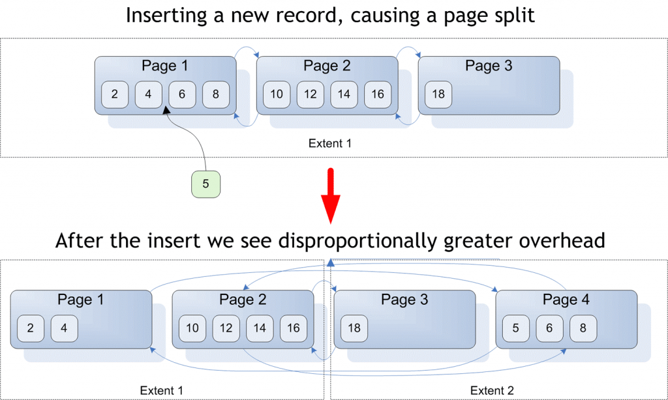
Page Splits
Notes:
Key Points:
Fragmentation will be covered in detail in coming lessons.
References :
https://social.technet.microsoft.com/wiki/contents/articles/40339.sql-server-what-is-fragmentation.aspx
https://docs.microsoft.com/en-us/sql/relational-databases/pages-and-extents-architecture-guide?view=sql-server-ver15

Slide 60
Read-Ahead Scans
Read Pages
Read-Ahead
Page 1
Page 2
Page 3
Page 4
Page 5
Page 6
Page 7
Page 8
Read-ahead anticipates the data and index pages needed to fulfill a query execution plan and brings the pages into the buffer cache before they are used by the query.
The read-ahead mechanism allows the Database Engine to read up to 64 contiguous pages (512KB) from one file.
Notes:
Reading Pages - SQL Server | Microsoft Docs

Slide 61
SQL Index Fragmentation and Maintenance options
SSMS -> Index Physical Statistics report
Will report fragmentation and recommend solution at database level
Custom Solution
Find fragmentation using Sys.dm_db_index_physical_stats
Correct fragmentation
Can remove Index fragmentation using Rebuild or Reorganize option
 | ALTER INDEX… REBUILD | ALTER INDEX … REORGANIZE
Removes fragmentation | X | X
Removes free space | X
Resets fill factor | X
Updates statistics | X
Notes:
Key points:
Maintenance plans are simple options, but they do not scale well.
All indexes in a database will be maintained, whether they need to be or not.
To manage a manual approach, you will generally follow two steps:
Use a DMV to calculate the fragmentation for each index.
Write a script to loop over the results and maintain the indexes that need it.
Remove index Fragmentation
Rebuild - Drops and re-creates the index.
For rowstore indexes, rebuilding removes fragmentation, reclaims disk space by compacting the pages based on the specified or existing fill factor setting, and reorders the index rows in contiguous pages.
For columnstore indexes, rebuilding removes fragmentation, moves all rows into the columnstore, and reclaims disk space by physically deleting rows that have been logically deleted from the table.
Reorganize - Uses minimal system resources and is an online operation. No long-term blocking table locks. it defragments the leaf level of clustered and nonclustered indexes on tables and views by physically reordering the leaf-level pages to match the logical, left to right, order of the leaf nodes.
Recommendations
avg_fragmentation_in_percent value Corrective statement
>5% and < = 30% ALTER INDEX REORGANIZE
> 30% ALTER INDEX REBUILD WITH (ONLINE = ON/OFF)
=============
More Information
=============
DMV
Sys.dm_db_index_physical_stats
( { database_id | NULL | 0 | DEFAULT } , { object_id | NULL | 0 | DEFAULT } , { index_id | NULL | 0 | -1 | DEFAULT } , { partition_number | NULL | 0 | DEFAULT } , { mode | NULL | DEFAULT } )
sys.dm_db_index_physical_stats requires only an Intent-Shared (IS) table lock, regardless of the mode that it runs in.
Scanning Modes: LIMITED, SAMPLED or DETAILED
The LIMITED mode is the fastest mode and scans the smallest number of pages. For an index, only the parent-level pages of the B-tree (that is, the pages above the leaf level) are scanned. For a heap, the associated PFS and IAM pages are examined and the data pages of a heap are scanned in LIMITED mode.
The SAMPLED mode returns statistics based on a 1 percent sample of all the pages in the index or heap. Results in SAMPLED mode should be regarded as approximate. If the index or heap has fewer than 10,000 pages, DETAILED mode is used, instead of SAMPLED.
The DETAILED mode scans all pages and returns all statistics – both fragmentation as well as free space available on the index.
The modes are progressively slower from LIMITED to DETAILED, because more work is performed in each mode.
It is rare to use DETAILED mode in larger databases, because it requires reading all the pages in the database. Therefore, database administrators (DBAs) often are unaware of how much free space is currently available in indexes.
For a good example of the logic required to write a custom solution, see https://ola.hallengren.com/
Rebuilding indexes accomplishes much more than reorganizing, but that comes at a cost.
Rebuilds are more intensive, potentially using tempdb resources, causing high I/O, and causing log growth. The larger the table, the more likely these are to become issues. This is because rebuilding indexes moves all the data on the pages around, in order to eliminate free space. This is done in a single transaction, which can cause the log to fill.
Reorganize
In contrast, reorganize works by locking two pages that are out of order, swapping them, and then releasing the locks. This is a very quick process, and each swap is a separate transaction.
Like most processes that work “one at a time”, reorganizes can take longer than rebuilds. Therefore, reorganizes typically are saved for indexes that are less than 30% fragmented. In these cases, the reduced IO requirements (<30% of all pages versus 100% of pages for rebuilds) keeps the impact of the reduced efficiency in check.
Note that REORGANIZE does not remove free space. If DBAs maintain indexes well, many indexes may never reach 30% fragmentation. Therefore, they never get rebuilt, and free space can grow significantly over time. Because the physical stats DMV is rarely run in DETAILED mode, free space problems are rarely observed. It may be a good idea to check for free space occasionally, or track indexes that are not rebuilt, so that they can be manually rebuilt over time to reclaim free space.
References:
https://docs.microsoft.com/en-us/sql/relational-databases/indexes/reorganize-and-rebuild-indexes?view=sql-server-ver15

Slide 62
Fill Factor
Can address performance issues due to fragmentation.
Reducing logical fragmentation.
Low fragmentation
High seeks and low scans
Index is not scanned
Use When
Specifying the amount of free space on a data or index page.
Do not use when
ALTER INDEX [pk_bigProduct]
ON [dbo].[bigProduct]
REBUILD WITH (PAD_INDEX = ON, FILLFACTOR = 90)
Notes:
Key Notes:
Setting a default fill factor is not a great approach, because the increase in total pages needed to store an index can be costly.
When deciding to set a fill factor, think about the following:
If low fragmentation, do not use fill factor.
If high seeks and low scans, do not use fill factor. Fragmentation only affects scans.
Therefore, if the index is not scanned, fragmentation is not as important, and fill factor is likely not needed.
If high fragmentation, test and see.
If fragmentation is causing performance issues, fill factor is one way to address it.
However, fill factors leave free space on a page, which is going to increase the total number of pages needed to store the index.
It is a trade-off, will a scan of the less fragmented index, with more sequential reads perform better?
Or will the scan of fewer data pages perform better?
Performance is going to vary, depending on the index.
=============
More Information
=============
How to tell?
Indexes on ascending values do not fragment.
Use sys.dm_db_index_stats for seek vs scan usage.
Collect fragmentation history as part of index maintenance.
How to set fill factor?
Option in CREATE INDEX and ALTER INDEX…REBUILD.
Once set, future REBUILDs will respect the setting until it is manually changed.
Techniques used to reduce fill factor, which have been discussed earlier in this lesson.
The exception is minimizing updates. This is not an indexing issue, but can definitely impact fragmentation.
Update in sets, rather than one at a time.
Do not insert with immediate update. Typically, this is done to look up values in other tables. Backfilling null values with the values looked up can increase the chance that the pages just added will not fit after the update.

Slide 63
Reducing fragmentation
Reducing Fragmentation
Using an ascending key (not always possible).
Using an appropriate fill factor for the workload.
Update in sets, rather than one at a time.
Do not insert with immediate update.
Notes:
Key Notes:
Choosing Indexes
Always evaluate duplicate/redundant/similar indexes before creating new index, technique called Index consolidation.
sys.dm_db_missing_index_details
sys.dm_db_index_usage_stats
Reducing Fragmentation
This slide goes over some of the techniques used to reduce fill factor, which have been discussed earlier in this lesson.
The exception is minimizing updates.
This is not an indexing issue, but can definitely impact fragmentation.
Update in sets, rather than one at a time.
Do not insert with immediate update. Typically, this is done to look up values in other tables. Backfilling null values with the values looked up can increase the chance that the pages just added will not fit after the update.

Slide 64
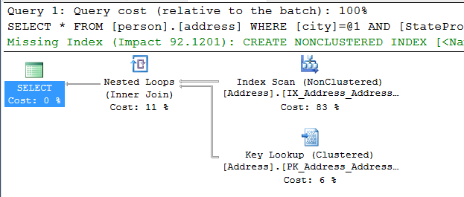
Missing Index Recommendations
SQL Server identifies indexes that would help a query’s performance
The recommendation is included in the query plan
The cost savings are aggregated in DMVs to help identify the most beneficial indexes
Notes:
Key points:
Reviewing index usage is a great way to decide which indexes are not needed. However, you also need a way to find indexes that need to be added.
To support this, Microsoft SQL Server identifies indexes that would benefit a query when the query is being compiled, and includes it in the query plan. In addition, SQL Server keeps a running tally of the total cost benefit to the query. As queries are executed more often, the total cost saving grows. Doing so lets you prioritize the indexes that need to be added.
Database Tuning Advisor makes index recommendations as well.

Slide 65

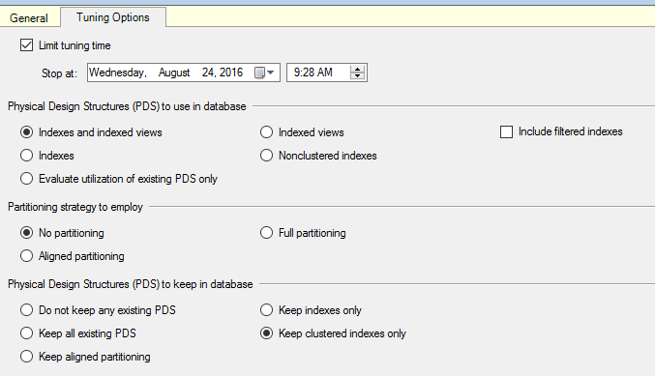
Choosing Indexes
Following sources can help you choosing indexes
Missing Index recommendations
sys.dm_db_index_usage_stats
Database Tuning Advisor
Notes:
Key Notes:
Choosing Indexes
Always evaluate duplicate/redundant/similar indexes before creating new index , technique called Index consolidation.
sys.dm_db_missing_index_details –>covered in detail in upcoming chapter.
sys.dm_db_index_usage_stats –>covered in detail in upcoming chapter along with operational stats.
Reducing Fragmentation
This slide goes over some of the techniques used to reduce fill factor, which have been discussed earlier in this lesson.
The exception is minimizing updates.
This is not an indexing issue, but can definitely impact fragmentation.
Update in sets, rather than one at a time.
Do not insert with immediate update. Typically, this is done to look up values in other tables. Backfilling null values with the values looked up can increase the chance that the pages just added will not fit after the update.

Slide 66
Demonstration
Analyzing Index Usage
Show how index usage patterns can help identify index and query improvements.
Notes:
M05L05Demo01
Consider demoing the following: E:\Demos\M05L05Demo01\IndexUsage.sql

Slide 67
Index Maintenance
Identifying and removing physical index fragmentation
Notes:
M05L05Lab01
Link to lab: Use electronic material to complete the lab exercise “Index Maintenance”

Slide 68
Questions?

Slide 69
Knowledge Check
Which DMV/DMF are used to monitor index usage?
Does it make sense to add all SQL Server missing recommendations?
When Managed Lock Priority should be used?
Notes:
Answer 1:
sys.dm_db_index_usage_stats DMV and sys.dm_db_index_operational_stats DMF are used to monitor index usages.
Answer 2:
No it is not wise. Focus on the most beneficial ones, based on total cost savings may top 10. Compare those indexes against other recommendations for the same tables and against existing indexes to see if consolidating them give benefits, or to remove an existing index when adding a recommended one that is similar.
Answer 3:
MLP is used for online Indexes.

Slide 70
Lesson 5: Columnstore Indexes

Slide 71
Objectives
After completing this learning, you will be able to:
Understand the differences between rowstore and Columnstore indexes.
Understand the primary use case for Columnstore indexes.
Examine and monitor Columnstore indexes.

Slide 72
Rowstore INDEX design
Regular types of indexes (Clustered / Non-Clustered) wouldn’t be able to handle the workload.
It will be impractical to create indexes on all individual columns, or to create all possible column combinations.
Up to 1,000 indexes per table
Up to 16 columns for index key
900 bytes per clustered index
1700 bytes per non-clustered index

Slide 73
RowStore vs ColumnStore
Notes:
This material assumes that the audience understands the basics of Clustered Column Store Indexes, so this is just a really quick recap …

Slide 74
Rowstore vs Columnstore Tables
Clustered/Non-clustered rowstore index (OrderId)
Clustered columnstore index (OrderId)
Logical table structure
OrderId | PageId
82147 | 1001
98137 | 1002
Rowgroup1 Min (OrderId): 82147 | Max (OrderId): 85395
OrderId | Date | Name | Country
85016 | 11-2-2018 | V | UK
85018 | 11-2-2018 | Q | SP
85216 | 11-2-2018 | Q | DE
85395 | 11-2-2018 | V | NL
82147 | 11-2-2018 | Q | FR
86881 | 11-2-2018 | D | UK
93080 | 11-3-2018 | R | UK
94156 | 11-3-2018 | S | FR
96250 | 11-3-2018 | Q | NL
98799 | 11-3-2018 | R | NL
98015 | 11-3-2018 | T | UK
98310 | 11-3-2018 | D | DE
98979 | 11-3-2018 | Z | DE
98137 | 11-3-2018 | T | FR
… | … | … | …
OrderId
82147
85016
85018
85216
85395
Country
FR
UK
SP
DE
NL
OrderId | PageId
82147 | 1005
85395 | 1006
OrderId | PageId
98137 | 1007
98979 | 1008
…
…
Name
Q
V
OrderId | Date | Name | Country
82147 | 11-2-2018 | Q | FR
85016 | 11-2-2018 | V | UK
85018 | 11-2-2018 | Q | SP
OrderId | Date | Name | Country
98137 | 11-3-2018 | T | FR
98310 | 11-3-2018 | D | DE
98799 | 11-3-2018 | R | NL
Date
11-2-2018
OrderId | Date | Name | Country
82147 | 11-2-2018 | Q | FR
85016 | 11-2-2018 | V | UK
85018 | 11-2-2018 | Q | SP
OrderId | Date | Name | Country
98137 | 11-3-2018 | T | FR
98310 | 11-3-2018 | D | DE
98799 | 11-3-2018 | R | NL
+
Delta Rowstore
OrderId | Date | Name | Country
98137 | 11-3-2018 | T | FR
98310 | 11-3-2018 | D | DE
98799 | 11-3-2018 | R | NL
98979 | 11-3-2018 | Z | DE
Data is stored in a B-tree index structure for performant lookup queries for particular rows.
Clustered rowstore index: The leaf nodes in the structure store the data values in a row (as pictured above)
Non-clustered (secondary) rowstore index: The leaf nodes store pointers to the data values, not the values themselves
Data stored in compressed columnstore segments after being sliced into groups of rows (rowgroups/micro-partitions) for maximum compression
Rows are stored in the delta rowstore until the number of rows is large enough to be compressed into a columnstore
Notes:
Format slide

Slide 75
Columnstore Index Concept
Data
Row Group
Segments
Column store
2034857,23552534,26262569085923458958294582342-52935-2385349085295-25894-589245-285928592-5845829582-58258295849058-28592-58294582405982948529058409589584590285902859204582945825982058958290582945082905825-2502-45905-93245,vitoortkgldkggjwov j4o534585-0348565920345234059=3405943=-5923405=23950345923=509235=239560235932=46942306496046940693=46043693b069,hb05,b6905869347 87-987g89-9s8g-89-89 89-89-89mg89wer-t8t9et8-t-=8349652-=856=8=98t0e=t9e0t=e9t09=90=39560=659450693=565096=35695=69305=69,vw06=62=96069,b]si5=96292500000-2034857,23552534,26262569085923458958294582342-52935-2385349085295-25894-589245-285928592-5845829582-58258295849058-28592-58294582405982948529058409589584590285902859204582945825982058958290582945082905825-2502-45905-93245,vitoortkgldkg vlgjwov j4o534585-0348565920345234059=3405943=-5923405=23950345923=509235=239560235932=46942306496046940693=46043693b069,hb05,b6905869347 87-987g89-9s8g-89-89 89-89-89mg89wer-t8t9et8-t-=8349652-=856=8=98t0e=t9e0t=e9t09=90=39560=659450693=565096=35695=69305=69,vw06=62=96069,b]si5=96292500000-2034857,23552534,26262569085923458958294582342-52935-2385349085295-25894-589245-285928592-5845829582-58258295849058-28592-582945824059829485290584095892034857,23552534,26262569085923458958294582342-52935-2385349085295-25894-589245-285928592-5845829582-58258295849058-28592-58294582405982948529058409589584590285902859204582945825982058958290582945082905825-2502-45905-93245,vitoortkgldkggjwov j4o534585-0348565920345234059=3405943=-5923405=23950345923=509235=239560235932=46942306496046940693=46043693b069,hb05,b6905869347 87-987g89-9s8g-89-89 89-89-89mg89wer-t8t9et8-t-=8349652-=856=8=98t0e=t9e0t=e9t09=90=39560=659450693=565096=35695=69305=69,vw06=62=96069,b]si5=96292500000-2034857,23552534,26262569085923458958294582342-52935-2385349085295-25894-589245-285928592-5845829582-58258295849058-28592-58294582405982948529058409589584590285902859204582945825982058958290582945082905825-2502-45905-93245,vitoortkgldkg vlgjwov j4o534585-0348565920345234059=3405943=-5923405=23950345923=509235=239560235932=46942306496046940693=46043693b069,hb05,b6905869347 87-987g89-9s8g-89-89 89-89-89mg89wer-t8t9et8-t-=8349652-=856=8=98t0e=t9e0t=e9t09=90=39560=659450693=565096=35695=69305=69,vw06=62=96069,b]si5=96292500000-2034857,23552534,26262569085923458958294582342-52935-2385349085295-25894-589245-285928592-5845829582-58258295849058-28592-58294582405982948529058409589
2034857,23552534,26262569085923458958294582342-52935-2385349085295-25894-589245-285928592-5845829582-58258295849058-28592-58294582405982948529058409589584590285902859204582945825982058958290582945082905825-2502-45905-93245,vitoortkgldkggjwov j4o534585-0348565920345234059=3405943=-5923405=23950345923=509235=239560235932=46942306496046940693=46043693b069,hb05,b6905869347 87-987g89-9s8g-89-89 89-89-89mg89wer-t8t9et8-t-=8349652-=856=8=98t0e=t9e0t=e9t09=90=39560=659450693=565096=35695=69305=69,vw06=62=96069,b]si5=96292500000-2034857,23552534,26262569085923458958294582342-52935-2385349085295-25894-589245-285928592-5845829582-58258295849058-28592-58294582405982948529058409589584590285902859204582945825982058958290582945082905825-2502-45905-93245,vitoortkgldkg vlgjwov j4o534585-0348565920345234059=3405943=-5923405=23950345923=509235=239560235932=46942306496046940693=46043693b069,hb05,b6905869347 87-987g89-9s8g-89-89 89-89-89mg89wer-t8t9et8-t-=8349652-=856=8=98t0e=t9e0t=e9t09=90=39560=659450693=565096=35695=69305=69,vw06=62=96069,b]si5=96292500000-2034857,23552534,26262569085923458958294582342-52935-2385349085295-25894-589245-285928592-5845829582-58258295849058-28592-582945824059829485290584095892034857,23552534,26262569085923458958294
2034857,23552534,26262569085923458958294582342-52935-2385349085295-25894-589245-285928592-5845829582-58258295849058-28592-58294582405982948529058409589584590285902859204582945825982058958290582945082905825-2502-45905-93245,vitoortkgldkggjwov j4o534585-0348565920345234059=3405943=-5923405=23950345923=509235=239560235932=46942306496046940693=46043693b069,hb05,b6905869347 87-987g89-9s8g-89-89 89-89-89mg89wer-t8t9et8-t-=8349652-=856=8=98t0e=t9e0t=e9t09=90=39560=659450693=565096=35695=69305=69,vw06=62=96069,b]si5=96292500000-2034857,23552534,26262569085923458958294582342-52935-2385349085295-25894-589245-285928592-5845829582-58258295849058-28592-58294582405982948529058409589584590285902859204582945825982058958290582945082905825-2502-45905-93245,vitoortkgldkg vlgjwov j4o534585-0348565920345234059=3405943=-5923405=23950345923=509235=239560235932=46942306496046940693=46043693b069,hb05,b6905869347 87-987g89-9s8g-89-89 89-89-89mg89wer-t8t9et8-t-=8349652-=856=8=98t0e=t9e0t=e9t09=90=39560=659450693=565096=35695=69305=69,vw06=62=96069,b]si5=96292500000-2034857,23552534,26262569085923458958294582342-52935-2385349085295-25894-589245-285928592-5845829582-58258295849058-28592-582945824059829485290584095892034857,23552534,26262569085923458958294
Groups rows into batches up to 1,048,576 rows
Notes:
CCI –Taxonomy
Not really a clustered index – misnomer, the data is not ordered in a CCI
A ColumnStore is a different storage format for data (vs Row Store)
Replaces the Clustered index b-tree, hence the name
In a CCI, the data is split:
Into Rowgroups, of up to 1,048,576 rows (2 ^ 20), referred to as 1M* rows in this presentation
Rowgroups are split by columns, into segments
Each segment is compressed individually into separate BLOBs
Each segment will compress much better than Page compression, mostly due to a consistent data type, and hence more repeating values.
Dictionary compression will take repeating values and store then in an associated Dictionary, and replace the value with a pointer. Dictionaries are specific to the RowGroup, not shared or global.
Examples of repeating values that could be put in a dictionary:
Data Type Dictionary entry Covered values
String Server SQL Server / Server OS / Windows Server
INT 10000 10001 / 10250 / 10999
Date 2020/01 2020/01/01 / 2020/01/15 / 2020/01/31
CCI Compression up to 15x.

Slide 76
Row Groups & Segments
Columns
Segments
C1
C2
C3
C4
C5
C6
Segment
Contains values for one column for a set of rows.
Segments are compressed.
Each segment is stored in a separate LOB.
It is a unit of transfer between disk and memory.
Row Group
Segments for the same set of rows
comprise a row group.
Position of a value in a column indicates to which
row it belongs to.
Row group
Segment
Notes:
For high performance and high compression rates, the columnstore index slices the table into groups of rows, called row groups, and then compresses each row group in a column-wise manner. The number of rows in the row group must be large enough to improve compression rates, and small enough to benefit from in-memory operations.
A rowgroup is a group of rows that are compressed into columnstore format at the same time.
A column segment is a column of data from within the rowgroup.
Each rowgroup contains one column segment for every column in the table.
Each column segment is compressed together and stored on physical media.

Slide 77
Columnstore Index Types
Clustered Index
Use to store fact tables and large dimension tables for data warehousing workloads
Average of 10x Compressions
Non-Clustered Index
Use to perform analysis in real time on an OLTP workload.
IOT workloads that insert large volumes with minimal updates/deletes
Covers Entire Table
Can be created for subset of columns
May have one or more Nonclustered B-Tree Indexes
Notes:
Columnstore indexes for data warehousing.
Get started with columnstore for real-time operational analytics.
Key Points:
A columnstore index can be clustered or nonclustered. Both index function the same.
The difference is that NC index is a secondary index that’s created on a rowstore table.
Clustered columnstore index provides the primary storage for the entire table, while a nonclustered index is a secondary index that contains a copy of some of the columns in the underlying table.
Columnstore indexes are not well-suited for queries that seek specific individual values.
NCCI to perform analysis in a real time on OLTP
A clustered columnstore index can have one or more nonclustered B-tree indexes.
Enforce primary key and foreign key constraints on a clustered columnstore index. 2. Speed up queries that search for specific values or small ranges of values. 3. Speed up updates and deletes of specific rows.
Only one columnstore index can be created.
The NC columnstore index requires extra storage since it contains a copy of the data in the rowstore table.

Slide 78
Columnstore Index Types
SQL Server 2012
Only Non-Clustered, Non-Updatable Columnstore Indexes.
Only available in Enterprise Edition.
SQL Server 2014
Introduced Updatable, Clustered Columnstore Indexes
Only available in Enterprise Edition.
SQL Server 2016
Introduced Updatable, Non-Clustered Columnstore Indexes
Available on Standard Edition. (Service Pack 1)
SQL Server 2019
Online rebuilds for Clustered Columnstore Indexes.
Notes:
Columnstore indexes for data warehousing.
Get started with columnstore for real-time operational analytics.
Key Points:
A columnstore index can be clustered or nonclustered. Both index function the same.
The difference is that NC index is a secondary index that’s created on a rowstore table.
Clustered columnstore index provides the primary storage for the entire table, while a nonclustered index is a secondary index that contains a copy of some of the columns in the underlying table.
Columnstore indexes are not well-suited for queries that seek specific individual values.
NCCI to perform analysis in a real time on OLTP
A clustered columnstore index can have one or more nonclustered B-tree indexes.
Enforce primary key and foreign key constraints on a clustered columnstore index. 2. Speed up queries that search for specific values or small ranges of values. 3. Speed up updates and deletes of specific rows.
Only one columnstore index can be created.
The NC columnstore index requires extra storage since it contains a copy of the data in the rowstore table.

Slide 79
Delta Store
Page compressed b-tree like a row store
B-tree on unique integer row ID
Matches user columns defined in the CCI
Aligned to underlying CCI partition
Small bulk loads of less than 102,400 rows, go directly to the deltastore.
Max # rows
delta store
1,048,576
Notes:
Deltastore
A columnstore index can have more than one delta rowgroup. All of the delta rowgroups are collectively called the deltastore.
During a large bulk load, most of the rows go directly to the columnstore without passing through the deltastore. Some rows at the end of the bulk load might be too few in number to meet the minimum size of a rowgroup, which is 102,400 rows. As a result, the final rows go to the deltastore instead of the columnstore. For small bulk loads with less than 102,400 rows, all of the rows go directly to the deltastore.
Columnstore indexes: Overview
https://docs.microsoft.com/en-us/sql/relational-databases/indexes/columnstore-indexes-overview?view=sql-server-ver15

Slide 80
Small DML Against the Column Store
Inserts
Below threshold? Write to the delta store
Above threshold? Write as column store
Deletes
Logical against rows in column store
Physically against rows in the delta store
Updates
Converted to a logical delete and an insert
Notes:
NEEDS VERIFICATION
Rows affected by update = # distinct values affected by the update not actual rows updated

Slide 81
Segment Elimination
Skips large chunks of data to speed up scans
Each partition in a column store index is broken into segments
Each segment has metadata that stores the minimum and maximum value of each column for the segment
The storage engine checks filter conditions against the metadata
If it detects no rows that qualify, it skips the entire segment without reading it from disk
Notes:
Segment elimination can increase the speed of data retrieval and it is important to understand the basics:
It will skip large chunks of data to speed up scans.
Each partition in a columnstore index is broken into segments.
Each segment has metadata that stores the minimum and maximum value of each column for the segment.
The storage engine checks filter conditions against the metadata.
If it can detect that no rows will qualify, then it skips the entire segment without even reading it from disk.

Slide 82
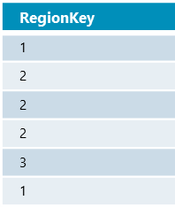
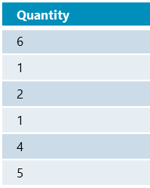
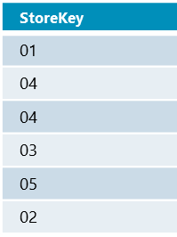
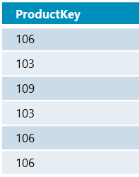
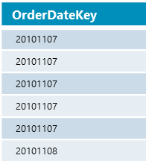
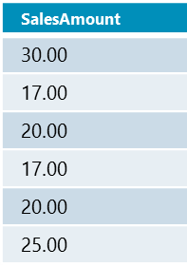

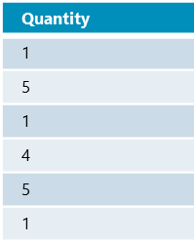
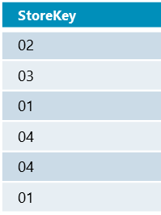
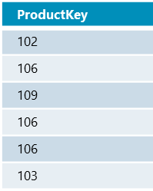
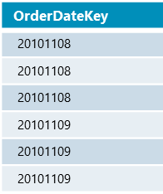
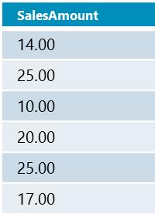
Segment / RowGroup Elimination
SELECT ProductKey,, SUM(SalesAmount)
FROM SalesTable
WHERE OrderDateKey < ’20101108’
Rowgroup # 1
Rowgroup # 2
Notes:
In the example, given the Select statement only references the ProductKey, SalesAmount and the OrderDateKey columns, the remainder of the columns do not get fetched. This is possible as the unit of storage for CCI is the segment which individually comprises data for a single column.
Segment elimination can skip large chunks of data to speed up scans. Each partition in a columnstore indexes is broken into 1M* row chunks called segments. Each segment has metadata that stores the minimum and maximum value of each column for the segment. The storage engine checks filter conditions against the metadata. If it can detect that no rows qualify, then it skips the entire segment without even reading it from disk.
The CCI itself stores data in a highly compressed format, with each column kept in a separate group of pages. This reduces I/O a lot for most data warehouse queries because many data warehouse fact tables contain 30 or more columns, while a typical query might touch only 5 or 6 columns. Only the columns touched by the query must be read from disk. Only the more frequently accessed columns have to take up space in main memory.
In the example, the predicate is “OrderDateKey < 20101108”
Using the predicate in the query and the segment metadata, the query processor is able to determine whether an entire RowGroup can be skipped or not thereby saving on IO and CPU time. In the example you visually see that an entire segment is eliminated as the min and max values are outside of the range of the predicate.
In this case, certain segments are skipped by both Segment and Rowgroup elimination, this is shown to illustrate that the elimination mechanisms operate independently.
On a partitioned table, partition elimination can work in conjunction with segment elimination.

Slide 83
Segment / RowGroup Elimination
Segment Elimination
SELECT ProductKey,, SUM(SalesAmount)
FROM SalesTable
WHERE OrderDateKey < ’20101108’
Rowgroup # 1
Rowgroup # 2
Notes:
In the example, given the Select statement only references the ProductKey, SalesAmount and the OrderDateKey columns, the remainder of the columns do not get fetched. This is possible as the unit of storage for CCI is the segment which individually comprises data for a single column.
Segment elimination can skip large chunks of data to speed up scans. Each partition in a columnstore indexes is broken into 1M* row chunks called segments. Each segment has metadata that stores the minimum and maximum value of each column for the segment. The storage engine checks filter conditions against the metadata. If it can detect that no rows qualify, then it skips the entire segment without even reading it from disk.
The CCI itself stores data in a highly compressed format, with each column kept in a separate group of pages. This reduces I/O a lot for most data warehouse queries because many data warehouse fact tables contain 30 or more columns, while a typical query might touch only 5 or 6 columns. Only the columns touched by the query must be read from disk. Only the more frequently accessed columns have to take up space in main memory.
In the example, the predicate is “OrderDateKey < 20101108”
Using the predicate in the query and the segment metadata, the query processor is able to determine whether an entire RowGroup can be skipped or not thereby saving on IO and CPU time. In the example you visually see that an entire segment is eliminated as the min and max values are outside of the range of the predicate.
In this case, certain segments are skipped by both Segment and Rowgroup elimination, this is shown to illustrate that the elimination mechanisms operate independently.
On a partitioned table, partition elimination can work in conjunction with segment elimination.

Slide 84
Segment / RowGroup Elimination
Segment Elimination
RowGroup Elimination
SELECT ProductKey,, SUM(SalesAmount)
FROM SalesTable
WHERE OrderDateKey < ’20101108’
Rowgroup # 1
Rowgroup # 2
Notes:
In the example, given the Select statement only references the ProductKey, SalesAmount and the OrderDateKey columns, the remainder of the columns do not get fetched. This is possible as the unit of storage for CCI is the segment which individually comprises data for a single column.
Segment elimination can skip large chunks of data to speed up scans. Each partition in a columnstore indexes is broken into 1M* row chunks called segments. Each segment has metadata that stores the minimum and maximum value of each column for the segment. The storage engine checks filter conditions against the metadata. If it can detect that no rows qualify, then it skips the entire segment without even reading it from disk.
The CCI itself stores data in a highly compressed format, with each column kept in a separate group of pages. This reduces I/O a lot for most data warehouse queries because many data warehouse fact tables contain 30 or more columns, while a typical query might touch only 5 or 6 columns. Only the columns touched by the query must be read from disk. Only the more frequently accessed columns have to take up space in main memory.
In the example, the predicate is “OrderDateKey < 20101108”
Using the predicate in the query and the segment metadata, the query processor is able to determine whether an entire RowGroup can be skipped or not thereby saving on IO and CPU time. In the example you visually see that an entire segment is eliminated as the min and max values are outside of the range of the predicate.
In this case, certain segments are skipped by both Segment and Rowgroup elimination, this is shown to illustrate that the elimination mechanisms operate independently.
On a partitioned table, partition elimination can work in conjunction with segment elimination.

Slide 85
Segment / RowGroup Elimination
Results
SELECT ProductKey,, SUM(SalesAmount)
FROM SalesTable
WHERE OrderDateKey < ’20101108’
Rowgroup # 1
Rowgroup # 2
Notes:
In the example, given the Select statement only references the ProductKey, SalesAmount and the OrderDateKey columns, the remainder of the columns do not get fetched. This is possible as the unit of storage for CCI is the segment which individually comprises data for a single column.
Segment elimination can skip large chunks of data to speed up scans. Each partition in a columnstore indexes is broken into 1M* row chunks called segments. Each segment has metadata that stores the minimum and maximum value of each column for the segment. The storage engine checks filter conditions against the metadata. If it can detect that no rows qualify, then it skips the entire segment without even reading it from disk.
The CCI itself stores data in a highly compressed format, with each column kept in a separate group of pages. This reduces I/O a lot for most data warehouse queries because many data warehouse fact tables contain 30 or more columns, while a typical query might touch only 5 or 6 columns. Only the columns touched by the query must be read from disk. Only the more frequently accessed columns have to take up space in main memory.
In the example, the predicate is “OrderDateKey < 20101108”
Using the predicate in the query and the segment metadata, the query processor is able to determine whether an entire RowGroup can be skipped or not thereby saving on IO and CPU time. In the example you visually see that an entire segment is eliminated as the min and max values are outside of the range of the predicate.
In this case, certain segments are skipped by both Segment and Rowgroup elimination, this is shown to illustrate that the elimination mechanisms operate independently.
On a partitioned table, partition elimination can work in conjunction with segment elimination.

Slide 86
Poor Workloads for CCI
Select * - lose the ability to do column elimination
Point-lookup – easier to find a particular row in a rowstore table
Selecting a range – rowstore can more easily grab that range of rows
A lot of DML – more overhead in CCI.
UPDATE = DELETE old row, INSERT new row
DELETE – rows are only logically deleted until an ALTER INDEX REBUILD* is issued

Slide 87
Batch Mode Processing
Process around 1000 rows at a time
As opposed to 1 row at a time with row-based processing
Not all query plan operators can perform batch processing
nested loops
Plan operators are expanded in SQL Server 2016+
Greatly reduced CPU time (7 to 40X)
merge join
Notes:
Batch mode processing uses a new iterator model for processing data a-batch-at-a-time instead of a-row-at-a-time. A batch typically represents about 1000 rows of data. Each column within a batch is stored as a vector in a separate area of memory, so batch mode processing is vector-based. Batch mode processing also uses algorithms that are optimized for the multicore CPUs and increased memory throughput that are found on modern hardware. Batch mode processing spreads metadata access costs and other types of overhead over all the rows in a batch, rather than paying the cost for each row. Batch mode processing operates on compressed data when possible and eliminates some of the exchange operators used by row mode processing. The result is better parallelism and faster performance and greatly reduced CPU time (7 to 40X).
Batch mode processing occurs only for parallel query execution. If the cost of the query plan is small, the optimizer may choose a serial plan that is "good enough." When experimenting with columnstore indexes, you may need a large data set to see the effects of batch mode processing. Check the degree of parallelism if you see that a query was executed in row mode when you expected batch mode.
The other consideration is segment elimination, which results in all but one segment being eliminated, inherently determining that DOP will be 1, as the unit of parallelism is the segment itself.

Slide 88
ColumnStore Index Performance
Measure the performance of rowstore indexes versus colunmstore indexes.
Notes:
M05L04Lab01
Link to lab: Use electronic material to complete the lab exercise “ColumnStore Index Performance”

Slide 89
Questions?

Slide 90
Knowledge Check
Name a primary reason for implementing a column store index?
What is the purpose of segments?
What is the purpose of row groups?
Notes:
To perform aggregate functions on large datasets efficiently. To compress data.
Segments allow the optimizer to have the storage engine eliminate data that is not required to satisfy the query.
Row groups allow for an optimal number of rows for the column store compression algorithm to be processed.

